Slide 1

Presentated by
Mukesh Sharma(2270205) &
Sriman Sandip Dash(2270366)

Slide 2
CONTENTS
01
02
03
04
05
Introduction
Objective
Methodology
System Design
Conclusion

Slide 3
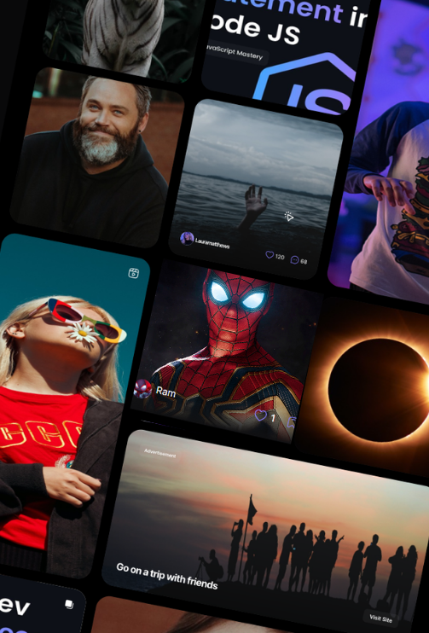
Introduction
Metagram presents a social media platform designed to foster connections and facilitate content sharing. Built with React and Typescript for a robust frontend, Metagram leverages Tailwind CSS for a modern and responsive design. Utilizing ShadCn's and Appwrite design expertise, the platform boasts an intuitive and user-friendly interface with robust database.

Slide 4
Objective
User Engagement
Content Creation and Sharing
Community Building
One objective could be to increase user engagement by implementing features such as likes, saves, create and follow. This encourages users to interact with each other and with the content on the platform, ultimately keeping them active and returning to the site regularly
Another objective might be to facilitate content creation and sharing by providing users with easy-to-use tools for uploading photos and text posts. Additionally, enabling users to share content from other sources helps to enrich the platform and foster community engagement
A third objective could focus on building and nurturing a sense of community among users. This could involve where users with similar interests can connect, share experiences, and support each other.

Slide 5
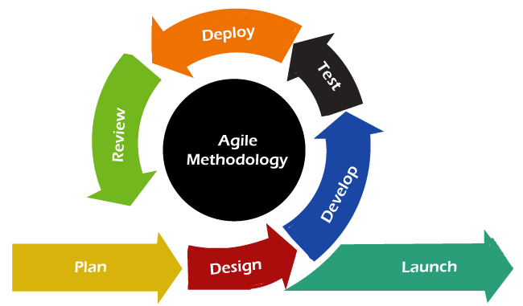
Methodology
Plan and Requirement Gathering: Understand user needs and create a backlog of user stories.
Design the Requirements: Plan how to address each user story.
Develop/Iteration: Build and test small increments of the software.
Testing/Quality Assurance: Ensure quality through continuous testing.
Deployment: Release working software.
Feedback: Gather feedback from users and stakeholders

Slide 6
System Design
System Design: The architecture and structure of a software system, detailing components, modules, and their interactions for efficient functionality.
Functional Requirements: Specifications outlining the system's behavior and features, such as user interface, data storage, and system responses.
Non-functional Requirements: Criteria defining system attributes like performance, reliability, security, and usability, ensuring quality beyond functional aspects.

Slide 7
0
Sign up/
Log in
Users
Information
API
Metagram
Figure 1.0 ( DFD Level-0 of Metagram )

Slide 8
0.1
0
Home page
0.2
Sign up/
Login
Log out
Figure 1.1 ( DFD Level-1 of Metagram )

Slide 9
Profile Page
0.1.1
0.1
Explore Page
0.1.2
Home page
People Page
0.1.3
Save Page
0.1.4
Create Page
0.1.5
Log out
0.2
Figure 1.2 ( DFD Level-2 of Metagram )

Slide 10
accountId
name
email
username
bio
liked
imageId
posts
imageUrl
User
Figure 1.3 (ER Diagram of Metagram )
Has many
Has many
Has many
creator
Post
caption
Save
likes
tags
ImageId
postId
userId
location
imageUrl

Slide 11
Conclusion
A social media website serves as a dynamic platform designed to foster user engagement, facilitate content creation and sharing, and promote community building. By prioritizing these objectives, the platform can effectively connect individuals, spark meaningful interactions, and cultivate a sense of belonging among its users. As technology continues to evolve, the possibilities for enhancing the user experience and expanding the platform's capabilities are endless. Through ongoing innovation and a commitment to meeting the needs of its community, a basic social media website can evolve into a thriving hub of connection, creativity, and collaboration in the digital age.

Slide 12
THANK YOU

